Slide 1
Week 6 Classroom Content

Slide 2
Events in JS
The change in the state of an object is known as an Event. In html, there are various events which represents that some activity is performed by the user or by the browser.
When javascript code is included in HTML, js react over these events and allow the execution. This process of reacting over the events is called Event Handling. Thus, js handles the HTML events via Event Handlers.
When a event occurs and it calls its associated function, it also passes a single argument to the function—a reference to the event object. The event object contains a number of properties that describe the event that occurred.
Ex- event.target will give the source of the event(if we click on a button tag,button tag is the source of the event,so event.target will be that button tag).

Slide 3
querySelector And querySelectorAll
document.querySelector(string) is used to select the first element from html page based on css selector either classname or id .
document.querySelectorAll(string) is used to select all the element from html page based on css selector either classname or id of those elements.
And it returns an array of objects referencing to the html elements.

Slide 4
Problem Statement
Create a Tic Tac Toe game using html ,css and Javascript.
The game should have a 9 cells in a 3x3 grid where each player will place his symbol either X or O at their turn.
The first turn will for symbol X.
The player who place 3 of his symbol adjacently either horizontally or vertically or diagonally will win
Game should have a restart button to clear all cells symbol and reset the game.

Slide 5
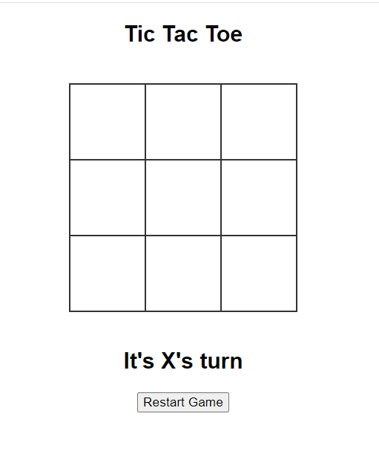
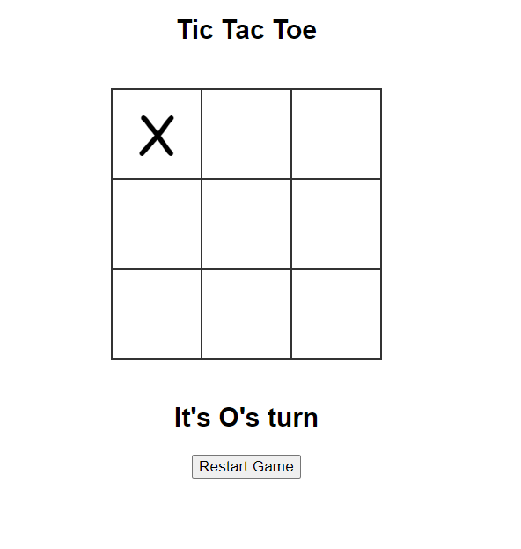
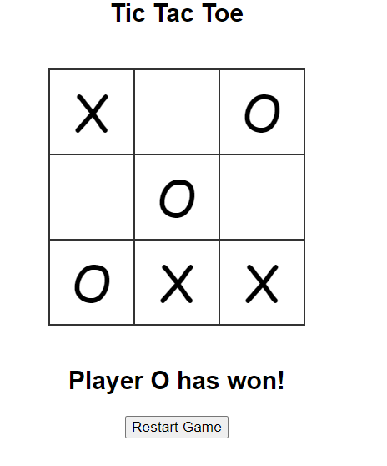
Sample Output

Slide 6
Thank You
Proprietary content. ©Great Learning. All Rights Reserved. Unauthorized use or distribution prohibited

